Slide 1
PACE CONNECT
TEAM 2
NIKHITA PATIL, SONAL SAHU, MABLE MACWAN, DRASHTI PATEL,AKSHAY MEHTA,SHARDUL VIRKAR

Slide 2

PROBLEM STATEMENT
Lack of an inclusive app that helps new students connect with the Pace alumni while also increasing engagement in the community.

Slide 3
APP OVERVIEW
PACE Connect is an app for new or current Pace students.
It will allow students to find accommodation availability around the campus, connect with Pace alumni to know more about courses or facilities at Pace, buy or sell items , get notifications about events happening in Pace.

Slide 4

PROJECT DESCRIPTION
Core features:
Help students find accomodation
Connect with Pace alumni students.
Buy/Sell Products
Notifications of events
Our role:
Infrastructure
Provide app skeleton
Enable team contributions
Maintain database

Slide 5
APPLICATION DEMO LINK
https://youtu.be/Nmols7WTmkQ

Slide 6
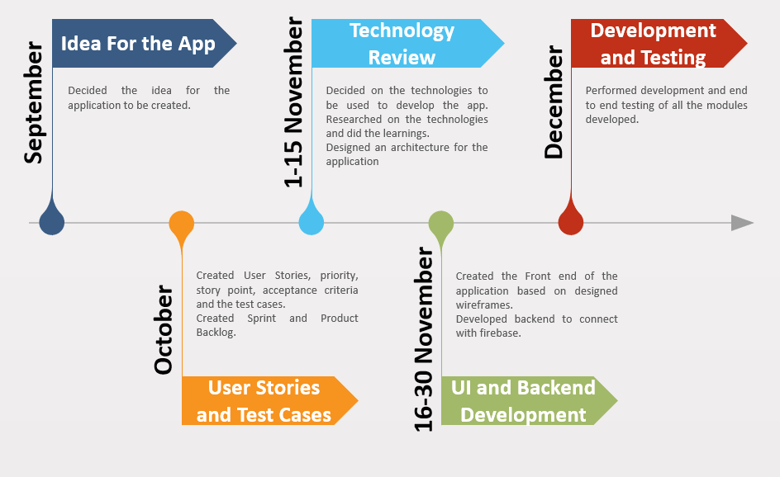
TIMELINE

Slide 7
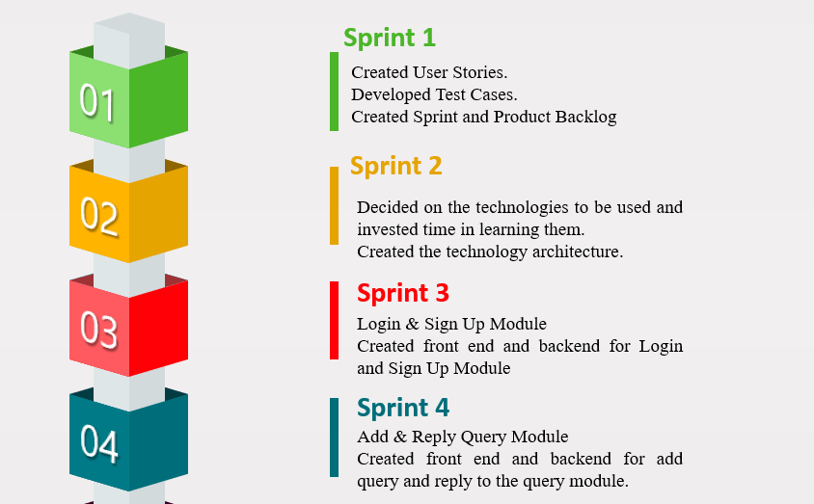
SPRINT OVERVIEW

Slide 8
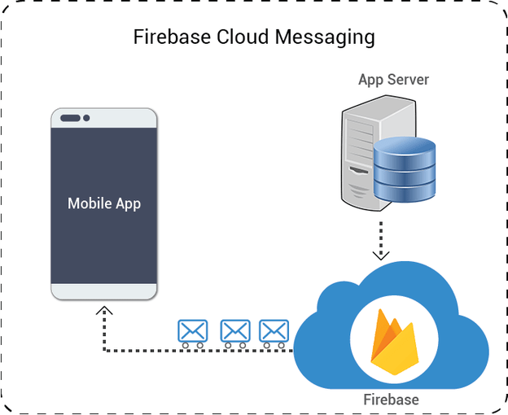
ARCHITECTURE

Slide 9
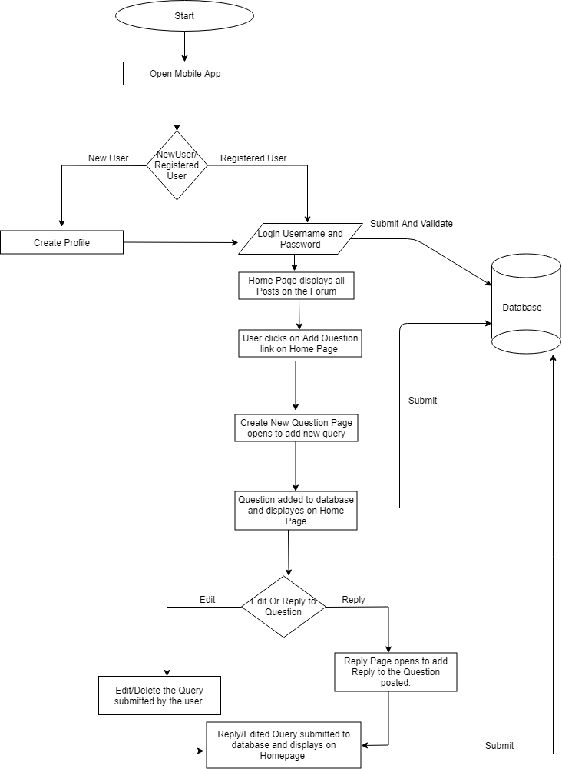
APPLICATION FLOW

Slide 10
TECHNOLOGIES
The technologies used for front end and backend are:
Front End- Android, Java, XML
Back End- Google firebase

Slide 11
Why we chose Android ?
Android platform is open source. The developers can use the SDK without any license issues.
Android-based applications are highly customizable and easier to manage.
Android apps are scripted in Java programming language that leverages a rich set of libraries.
Android is ruling the mobile device market with more than 75% of market share.

Slide 12
Why we chose FIREBASE ?
Firebase is a Backend-as-a-Service for mobile and web to build powerful apps.
The Firebase Real time Database is a cloud-hosted database. Data is stored as JSON and synchronized in real time to every connected client.
Cross Platform compatibility

Slide 13
FEATURES : FIREBASE
REAL-TIME Database: -No Structured Query Language
Data is stored and synced as a JSON design in real time to every customer connected.
ANALYTICS:- Firebase Google Analytics is free and unlimited analytics solution.
NOTIFICATION:-Using Firebase cloud messaging, a client receives a notification on the app whenever new mail or any data is synced.

Slide 14
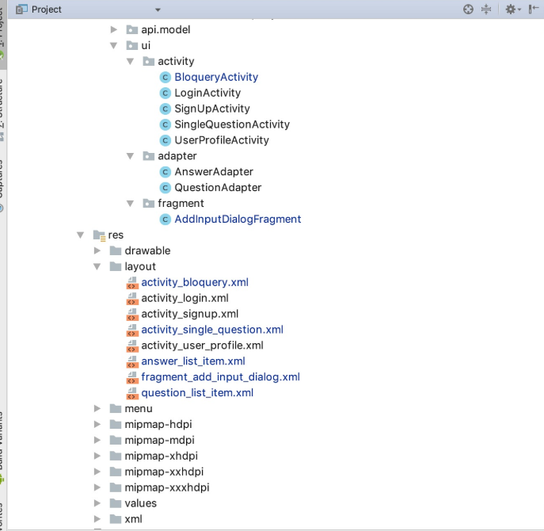
APP SKELETON

Slide 15
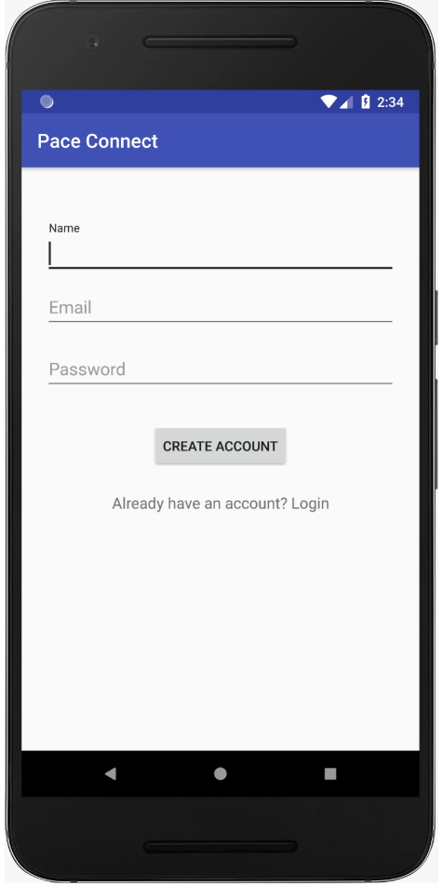
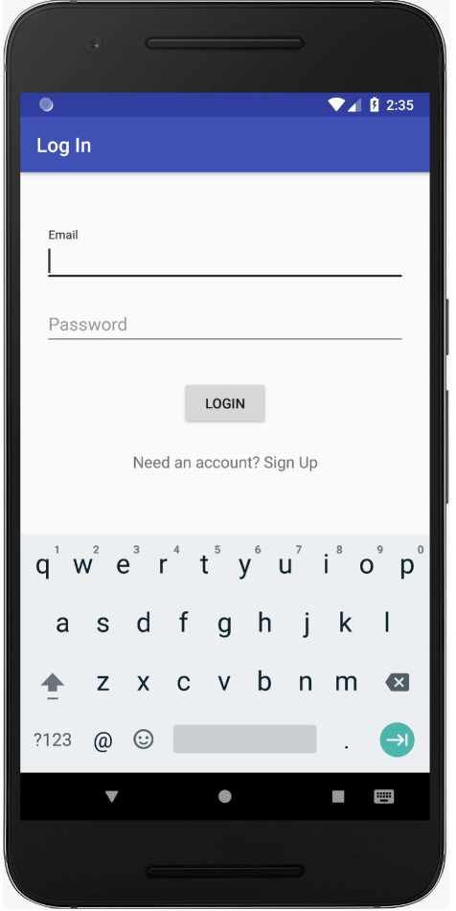
PRODUCT RESULT
Fig. Login Page

Slide 16
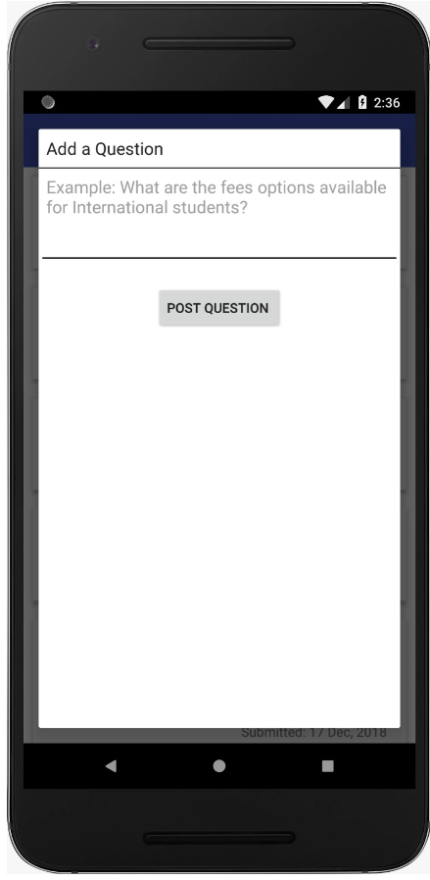
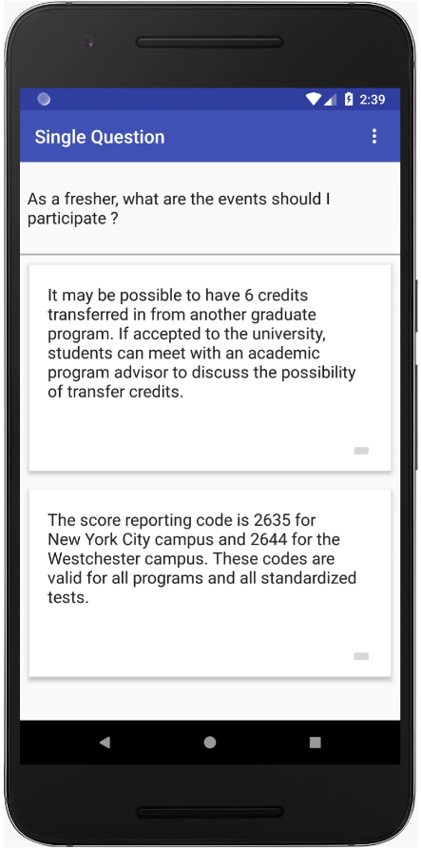
Fig. Adding a post and replying to a post on the forum

Slide 17
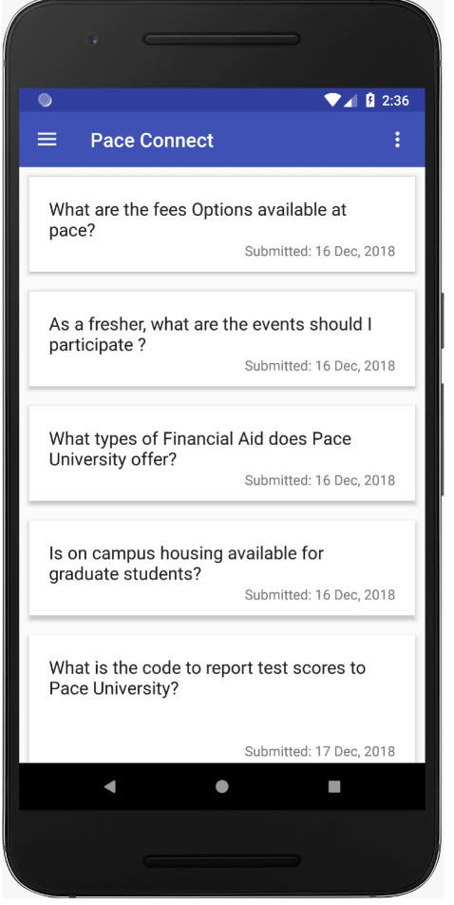
Fig. All questions posted on forum

Slide 18
STORY STATUS
User Story |  | Completion Status | Sprint Completed
Sign Up | As a new user , I want to sign up for an account so that I can create a profile to access Pace Connect app for posting queries on the discussion forum | In Progress
Log In | As a registered user, I want to log in with Pace Connect app so that I can access Pace Connect app for creating or replying to queries on the discussion forum. | Completed | Sprint 3
Forgot Password | As a registered user, I want to securely reset my password so that I can change my password if I forgot/misplaced my previous password. | Not Started
Post Query to Forum | As a registered user, I want to post a query, so that I can get replies from other students regarding accommodation availability, job openings, course enquiries etc. | Completed | Sprint 4
Reply Query To Forum | As a registered user, I want to reply on the existing query so that I can provide required information by replying to the queries posted on the forum. | Completed | Sprint 4
Edit/Delete Query To Forum | As a registered user, I want to edit or delete a query posted on the forum so that I can modify my existing post created by him to add/delete details to the post. | Not Started

Slide 19
SPRINT 4 ACCOMPLISHMENTS
Created Minimum viable product for Pace Connect App.
Implemented Front end and Backend development of Login, Sign Up and Add Post and Reply Post Module.
Successfully established communication of Android application with Firebase as database.
Uploaded the code on Github for team members to review and perform any further modifications.

Slide 20
FUTURE DEVELOPMENT STEPS
Creating Profile for student sign up.
Adding upvote and down vote to queries.
Forgot Password module implementation.
Edit and Delete module implementation.
Shipping to Google Play Store.

Slide 21
Thank you!!!

Slide 22

QUESTIONS

